Slide 1
Case Study
Scoil Mhuire - Magherarney, Smithborough, Co. Monaghan
School Coordinator:
Siobhán Payne
Creative Associate:
Joanna Behan
Notes:
Scoil Mhuire is a rural primary school located on the edge of Smithborugh village in County Monaghan. It is a 6 teacher school, 5 classroom teachers and one SET teacher.
There are 111 pupils and it is a mixed, vertical school.

Slide 2
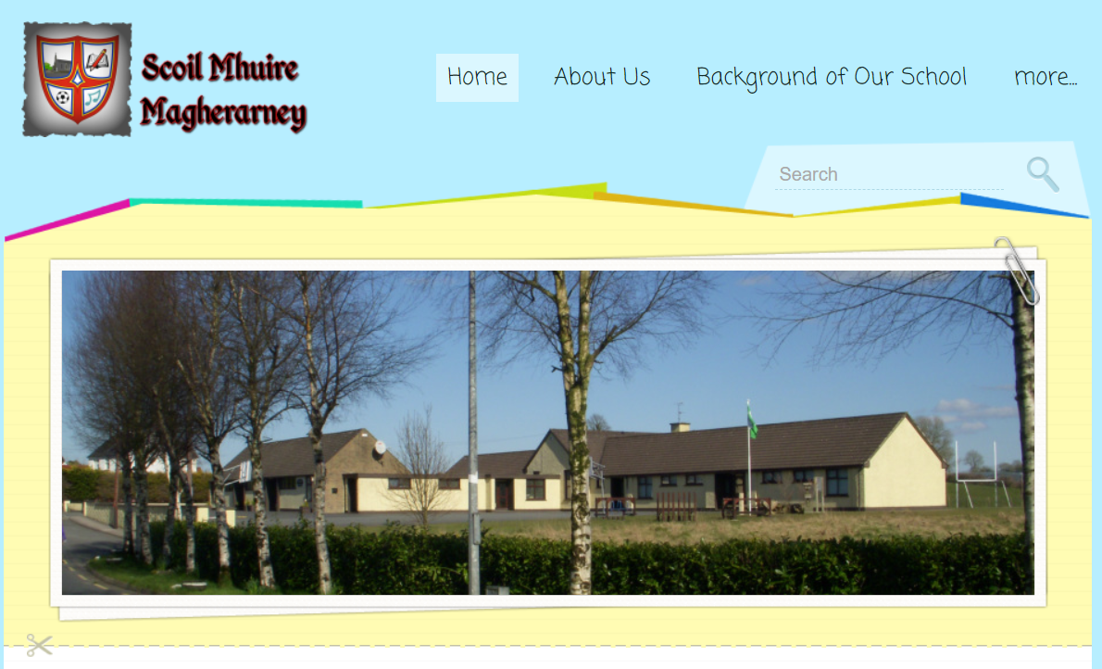
Creative Schools – Animation
www.magherarneyns.com
(Creative Schools Animation is the second video on the main home page)

Slide 3
Pupil Focus Group – Food for Thought
using a step by step approach
having time to plan, sketch ideas
having a chance to practice, explore and develop own ideas
taking time to stop and look
linking art to other subjects
Notes:
Why Creative Schools in Scoil Mhuire Magherarney?
As part of its SSE [School Self Evaluation] work Scoil Mhuire had focused on the Visual Arts area.
Within the process, Step 2 the ‘Gathering Evidence’ phase we had sought to gather both the pupil and teacher voice in relation to the teaching and learning of art.
Through using a focus group, comprising of pupils from Senior infants to Rang a Sé it was established that the children were experiencing all the strands within the art curriculum but points raised gave the teaching staff ‘food for thought’ regarding our approaches to teaching of the subject. - speak to the points on the slide
The pupil focus group reflections were used as a stimulus for whole staff discussion which was subsequently followed by a SOAR analysis – Strengths/Opportunities/Aspirations/Results
Reflections from teachers included:
process led activities
teach the basics
development of skills and concepts i.e. elements of art
connections to outside support/exp

Slide 4
Local Arts
in Education Partnership
Notes:
From the teachers’ sharing of perspectives it emerged there were confidence issues , many were unsure how to use their art lessons to develop the conceptual understanding of the elements of art for the pupils yet it was clear the potential opportunities to do so were there as a good balance of strands and strand units were evident but we felt we needed to know where we could access specific support and expertise in the Visual Arts.
There was also a clear connection between the pupil focus group and the teacher reflections as the teachers spoke to wanting a more process led approach to lessons and the pupils questioned why more time could not be spent on planning, designing and experimenting before committing to a particular direction in their pieces of work. It appeared both groups were interested in more ‘space’ being given to pupils for self expression which teachers believed would open the door for greater opportunities for creative exploration.
Correspondence from our local education center and other local groups such as The Cavan Monaghan Arts Partnership plus a connection we had with Joanne [our Creative Associate ] who was a past parent in our school altered us to the Creative Schools programme which upon examination held the potential to address many of the needs that we had identified in the SSE Process.

Slide 5
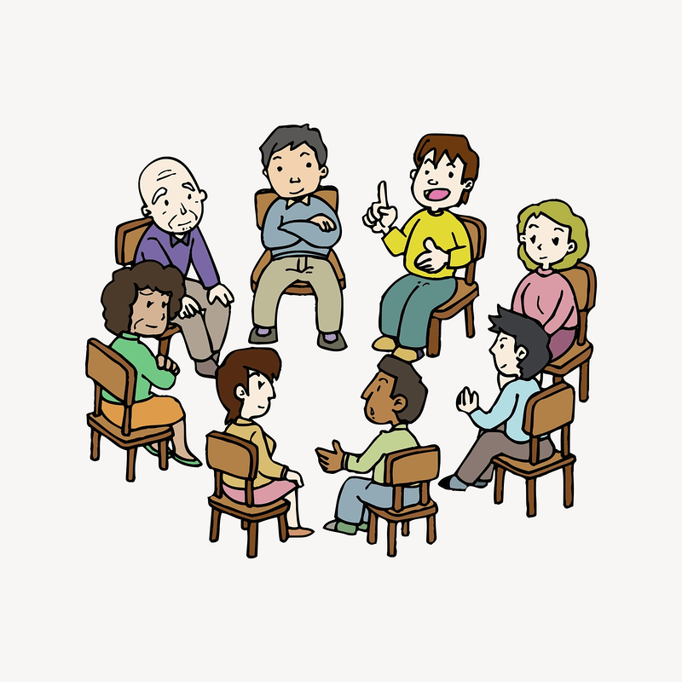
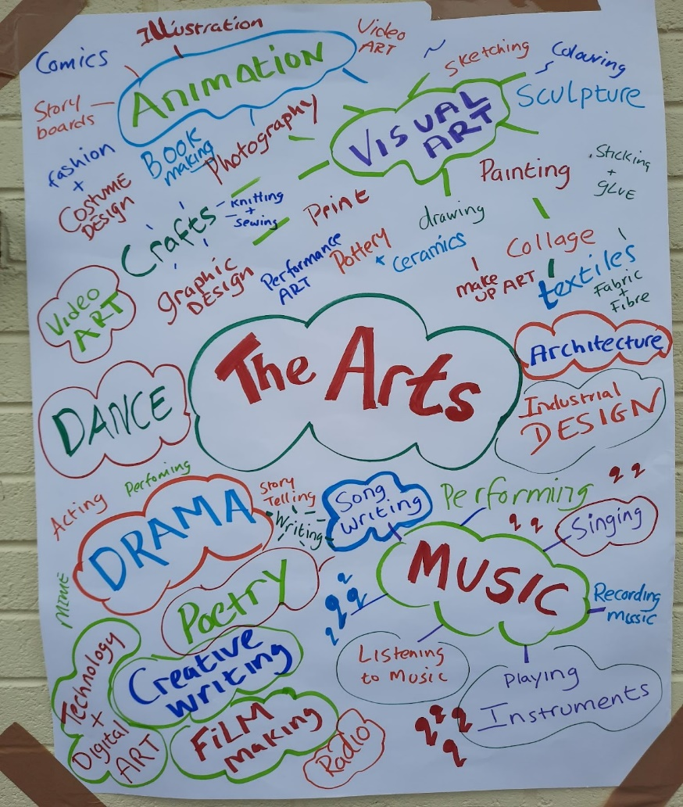
Getting to know the School Community
Notes:
Initial meetings, chats with coordinator, staff and children getting to know the school community
Figuring out where the school was at regarding creativity and understanding what the school might like to do develop more creativity in learning. This engagement gave the school time to consider what they wanted and needed from the CS programme. It was very apparent from the start that the school wanted creative schools to tie into the curriculum.
Joanne met with school coordinator first and then all school staff. She gave an overview of creative schools and breadth of possibilities, engaged in activities in figuring out where the school was at regarding creativity and considering areas they wanted to develop further. These activities were a great way to get everyone to start thinking about the possibilities of CS
During lockdown videos and activities were used to connect with the school community. This was a great way to also connect with the families and wider community. The videos and fun activities were a great opportunity for the children, parents and wider community to get excited and share their ideas

Slide 6
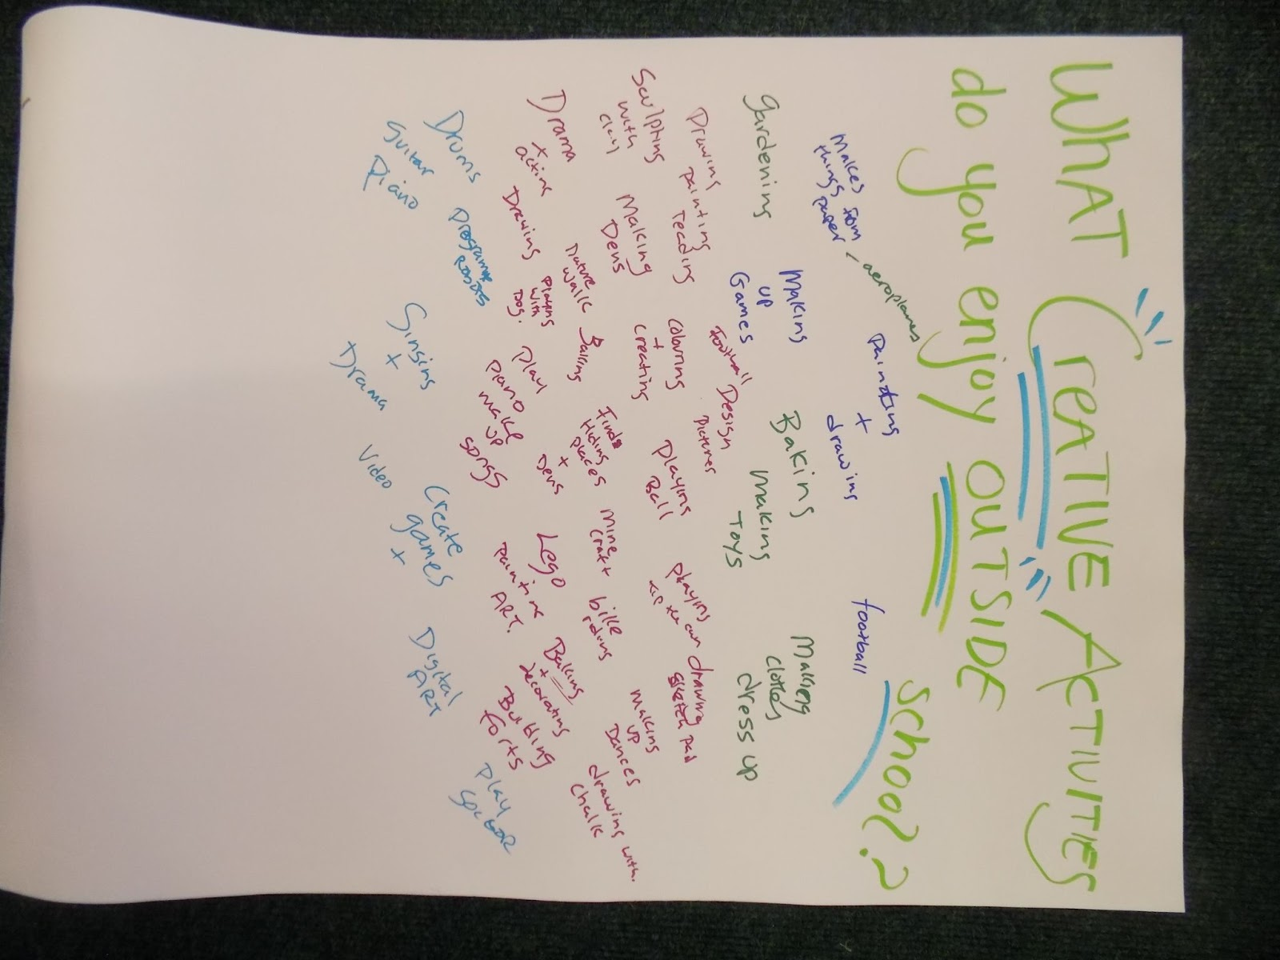
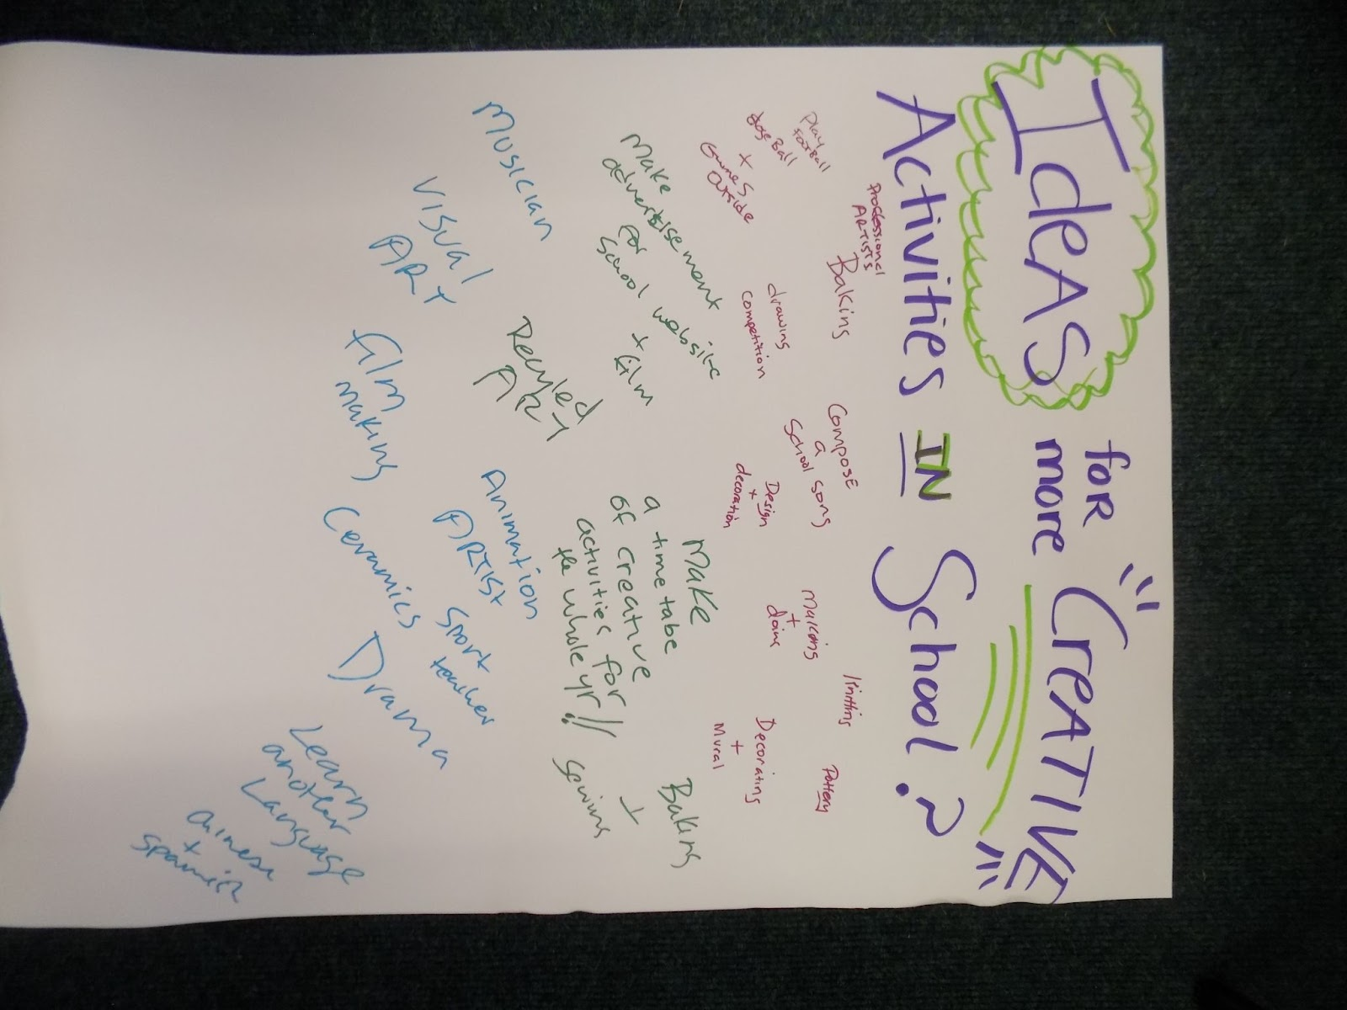
Exploring ‘Creativity’
Notes:
In-School Engagement - Outside workshop on Creativity due to social distancing restrictions still being in place

Slide 7
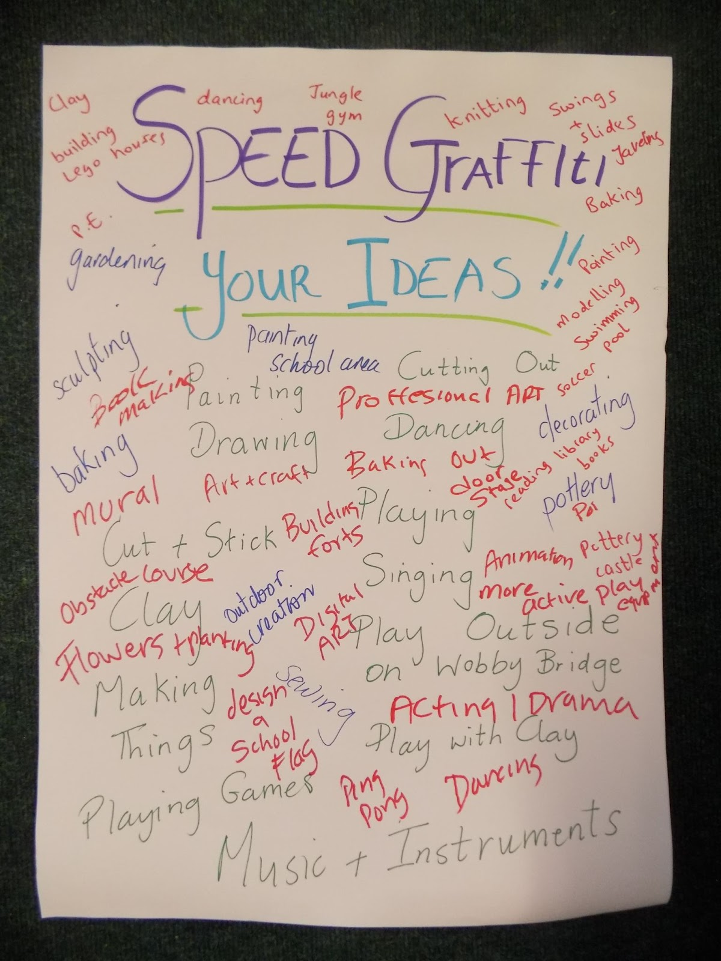
Exploring ‘Creativity
Notes:
Some games outside during period where social restrictions were still in place to engage with the pupils and hear the pupils voice,

Slide 8
Creativity and Remote Learning
Notes:
On Line creativity Task
The Creative Associate set a task for the pupils which was completed on-line during the second Lock Down- the pupils were asked to think about what ‘Creativity’ may look like in the school if they could use their imagination to consider any aspect of school or indeed to think about an element in their immediate environment that they could adapt and change creatively.
The pupils completed their drawings and recorded a narrated piece to explain their ideas. As we were using Seesaw this was the ideal way to share their ideas.

Slide 9
Creativity and Remote Learning
Notes:
On Line creativity Task
The Creative Associate set a task for the pupils which was completed on-line during the second Lock Down- the pupils were asked to think about what ‘Creativity’ may look like in the school if they could use their imagination to consider any aspect of school or indeed to think about an element in their immediate environment that they could adapt and change creatively.
The pupils completed their drawings and recorded a narrated piece to explain their ideas. As we were using Seesaw this was the ideal way to share their ideas.

Slide 11
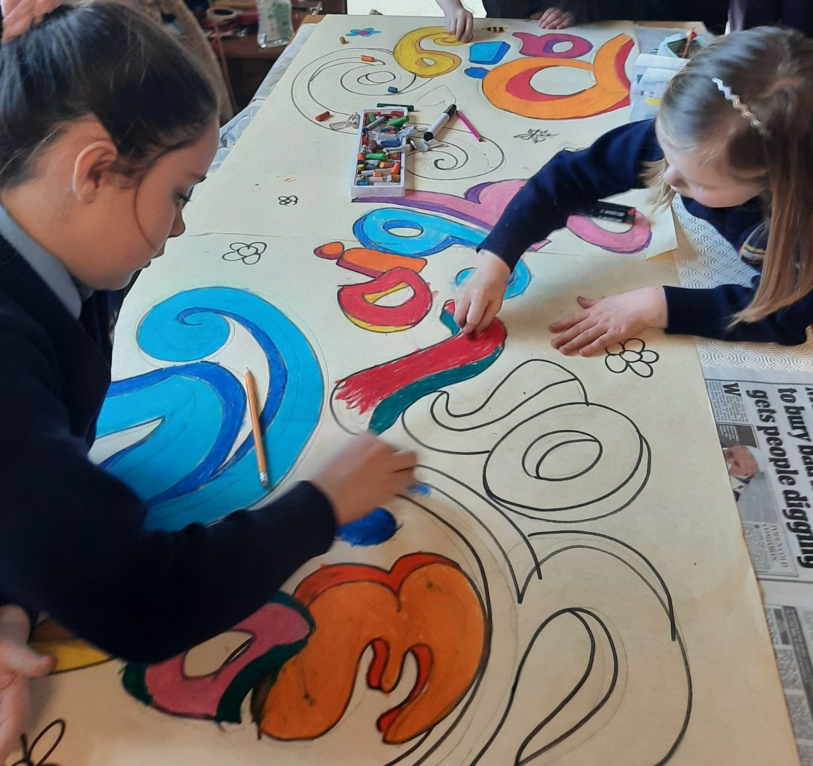
Making Connections
Notes:
Making connections and extra funding –link to Cavan Monaghan Arts Education Partnership:
Christmas engagement with drama and music
Infants to Second Class - Rockin Christmas Rhymes Branar Theatre Company Galway
Third to Sixth Class - A Christmas Carol ‘ Livin Dred Theatre Company

Slide 12
Connectivity - Cavan/Monaghan Local Arts & Education Partnership
Creative Classrooms
Dave Rudden - Creative Writing Workshop
Garry McCarthy - Rap, Beat Making & Song Writing
John D Ruddy - Comic Book Illustration Workshop
Leanne Mc Laughlin - Weaving Workshop
Duffy Mooney Sheppard- Drawing And Book Craft Workshop
Michael Fortune - Filmmaking and Editing Tips
Aileen Lambert - Traditional Singing Workshop
Notes:
One of biggest challenges was COVID and getting access to the children and the needs of the school at this time.
Joanne teamed up with Mary Farrelly and approached the LAEP for funds to develop a programme of creative pre-recorded workshops for all the schools participating in Creative Schools in the area.
These funds made it possible to pay artists and a programme of workshops were designed which gave schools the opportunity to engage with a variety of art forms at their own pace during lockdown. Many of the schools then engaged face to face with these artists in year 2 of Creative schools.

Slide 13
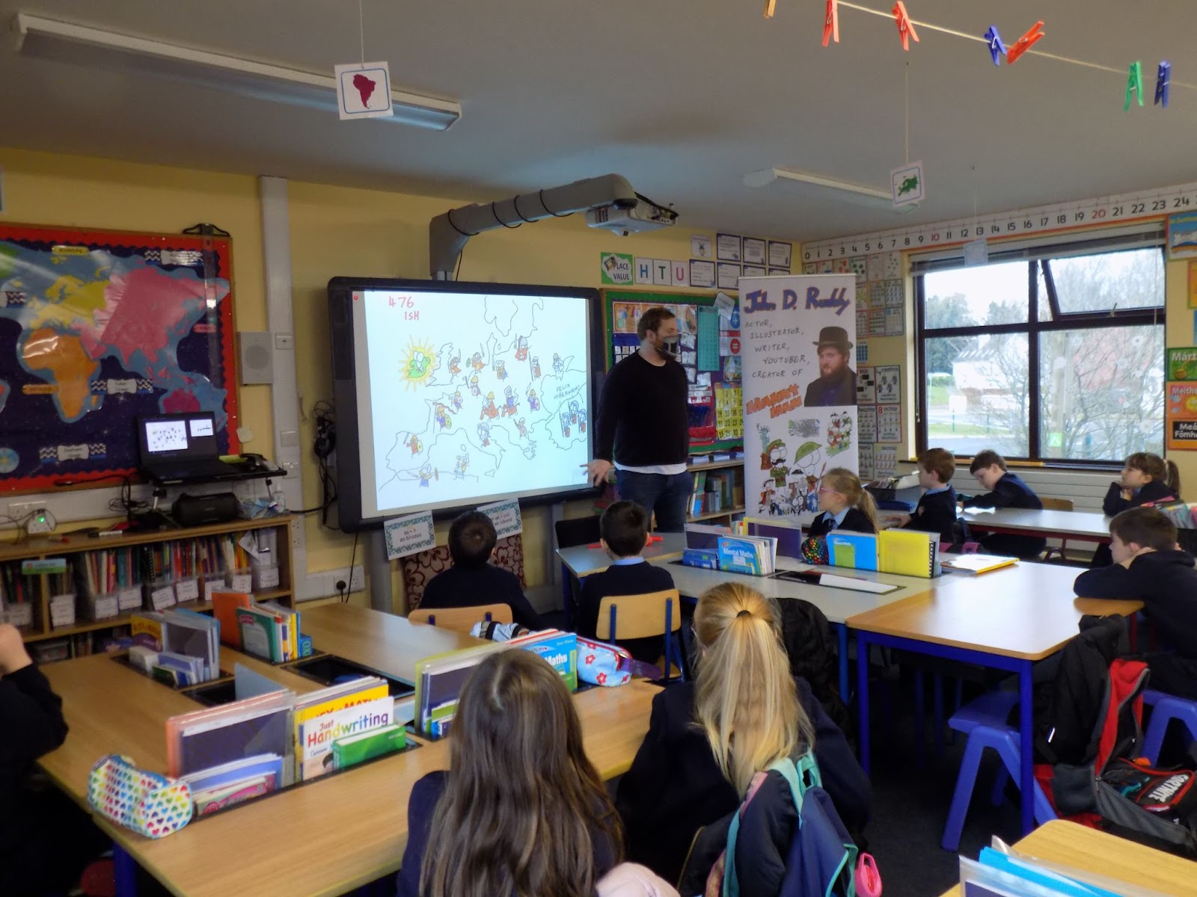
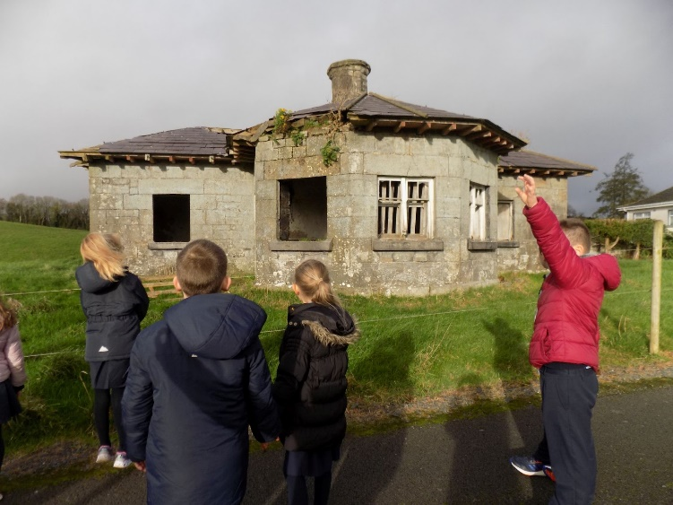
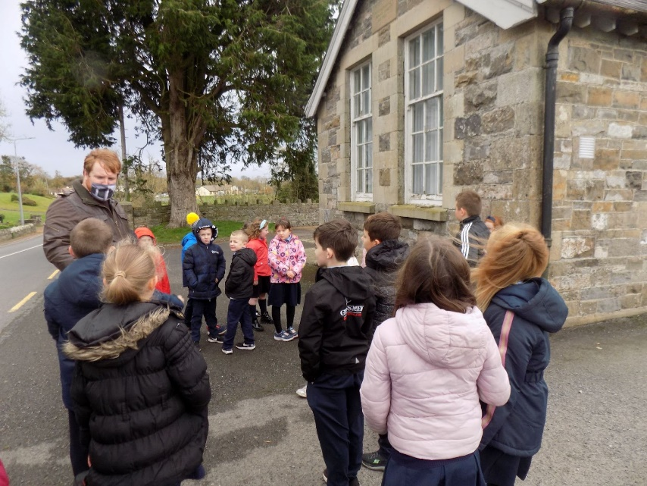
Connectivity - Heritage In Schools Link
Connectivity - Heritage In Schools Link
Notes:
Through engagement with the series of workshops on-line we became familiar with the work of John D Ruddy, actor, illustrator, writer and historian.
Joanne, our creative associate, highlighted that John visited schools through the Heritage in School Scheme and so we engaged John through the scheme to visit Scoil Mhuire twice where he
gave a summary of the History of Ireland through story telling – SESE History
brought the children out on a Local History Trail – use of the local environment - SESE Geography
and conducted a drawing lesson.- The Arts- Visual Arts
There was a huge level of engagement by the children because of John’s enthusiasm, vibrant and witty manner of presentation and slowly through
John’s own passion for history
An ever increasing curiosity of the pupils about their local place [intensified by the many family outings in the locality- walking/cycling/exploring , during lock down]
And teachers own awareness of the Local Studies Strand in History
the kernel of an idea began to emerge.
The linking in with John provided a great opportunity for the school SC, SA , Children & Artist to engage and plan our CS project. This planning was such an important part of the process and the success of the project.
CA - can help make connections to arts and cultural organisations & funding opportunities- a connection was also made with a native of the area, Ann Corley who is a genologist and who has also written two theses for her studies on aspects of local History.
As with all things projects such as this happen in the context of very busy schools. Discussions between teachers and John when he visited classrooms included reflections on the impact of the Covid Lock downs, our very quick fast forwarding of engagement with Digital technology and our concerns with the potential fall-out we may face regarding pupils wellbeing and reconnected to school together.
Again discussion with the SC, CA, John as facilitator and the staff brought us further into the idea of the whole school working collaboratively while still physically apart on a shared project that focused on our shared local area and environment and while developing the drawing strand incorporating digital technology through learning the new skill of animation.

Slide 14
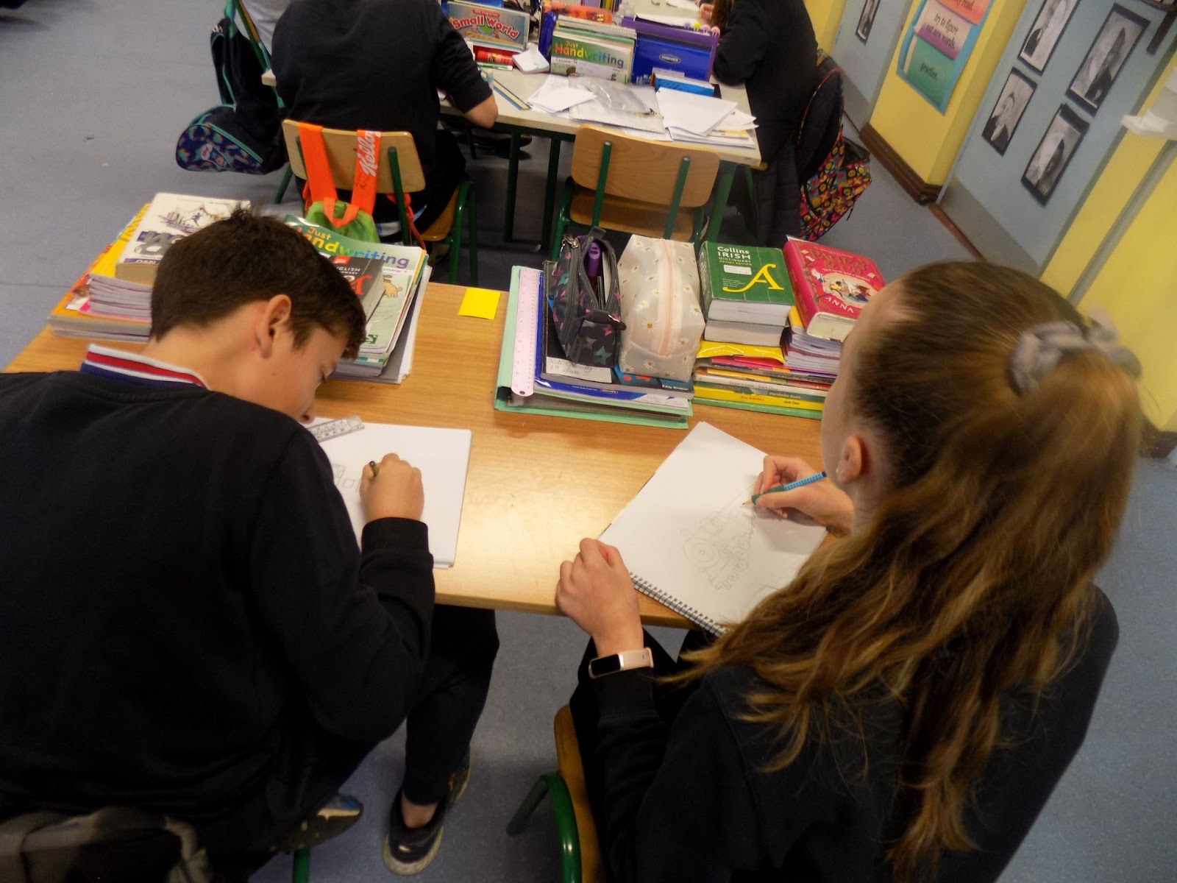
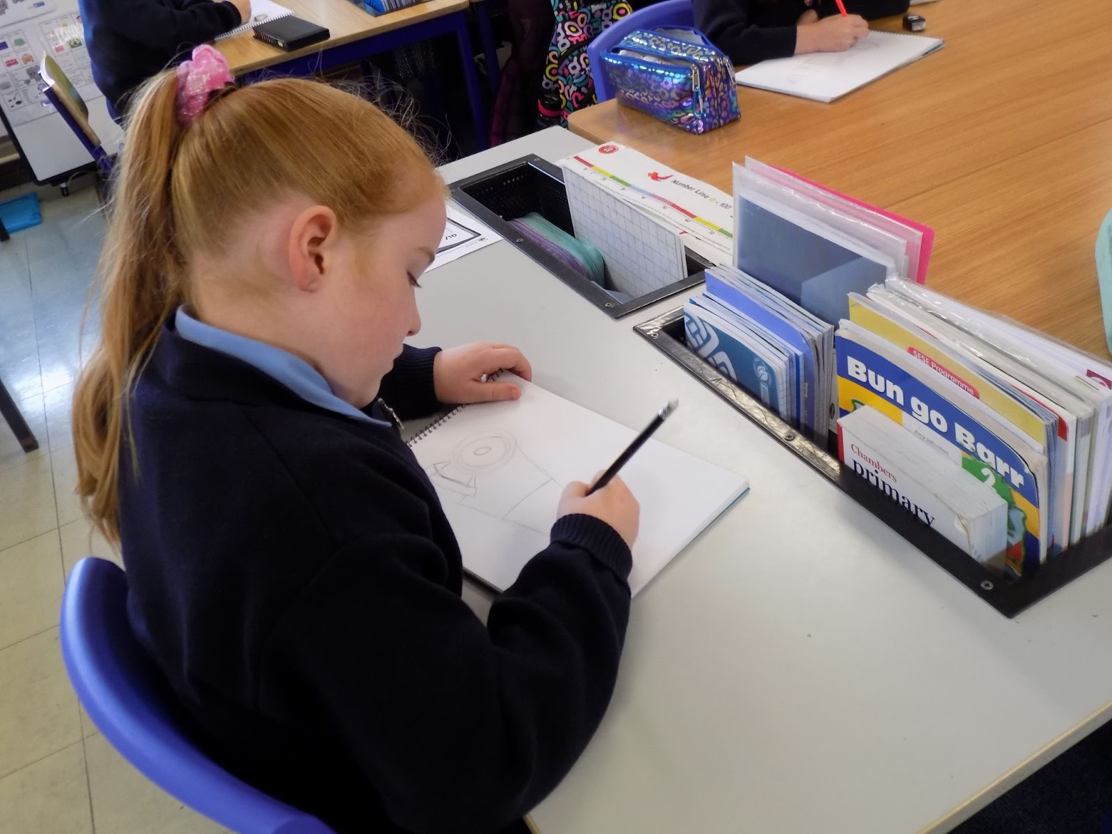
Connectivity - Heritage In Schools Link
Notes:
The emerging focus of our Creative Schools work really came from discussion , curriculum, exposure to different creative experiences and circumstance.

Slide 15
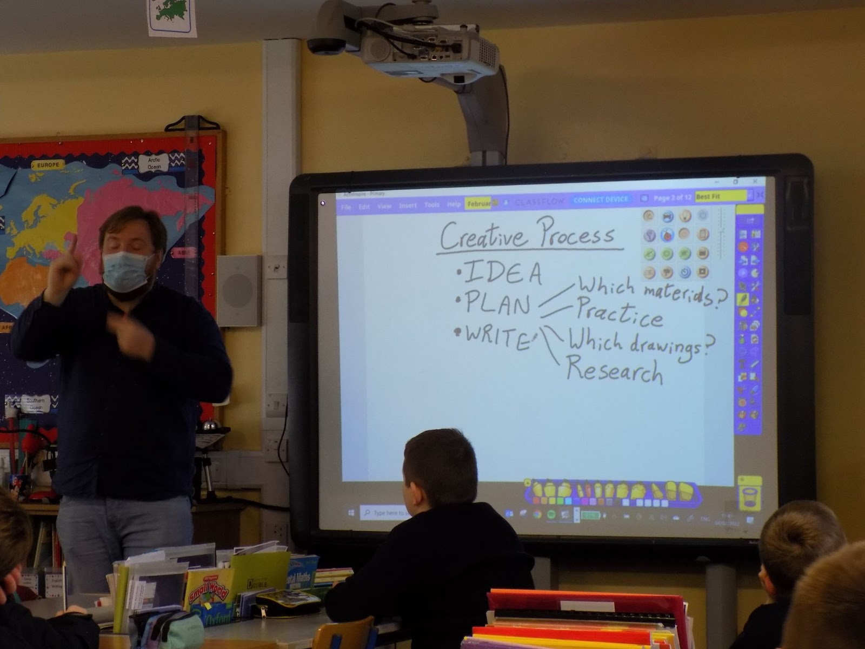
The Creative Process
A history of animation
Local area – possible focus – building discovery skills
Process
SESE Lessons
Notes:
John’s first visit in relation to Creative Schools related to developing an understanding for the children of the link between drawing and animation. He presented a history of animation and emphasised the huge quantity of drawing work, repetition of drawing and attention to detail needed to make a mere 30 secs of animation. And taught the children to do very simple animations to get the sense of a moving picture.
Consideration of the drawing skills and demands of possible topics, in addition to appropriate curriculum links and pupil interest saw John suggest class foci on Rang 1 & 2 would focus on the GNR Railway
Rang 3 & 4 would focus on the Creamery
Rang 5 & 6 would focus on the Ulster Canal which may have possibility for a STEM focus
The classes explored the idea that being creative is not necessarily a single event and a discussion took place that getting to our end goal would be a process with steps.
Linking in with members of the local community was a big part of this stage in order to gather information on the railway, canal and creamery. Photos, booklets, and recordings shared of older members of the community describing their memories of the railway station were used by the teachers to extend our own understanding of local studies and desing pupil friendly lessons

Slide 16
Our First Simple Animations
“ Oh yeah, I can see it, \
I can see it! “
“ Can we do our own animation?” yes! ……..I’m gonna …….
Notes:
On-Line- Creativity Task

Slide 17
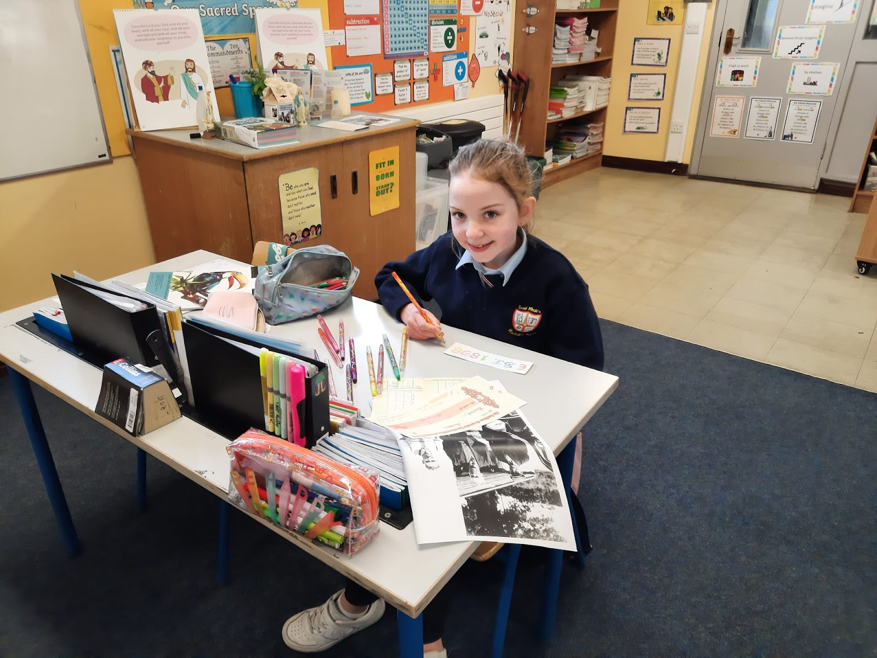
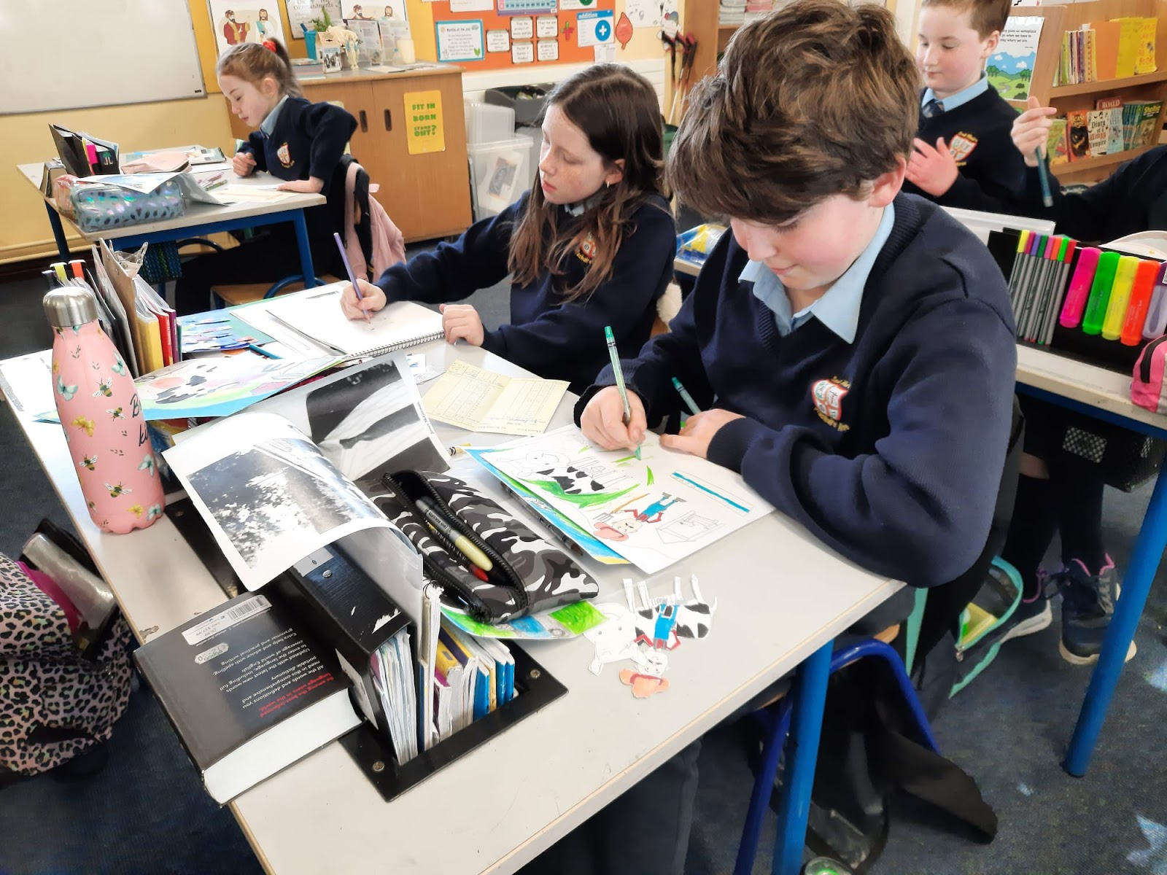
Using Photographs

Slide 18
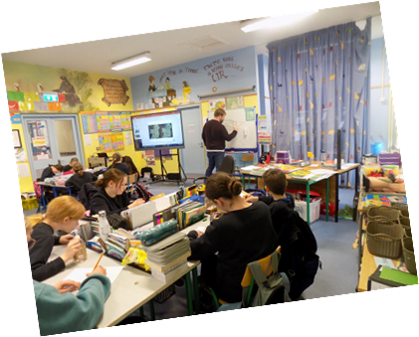
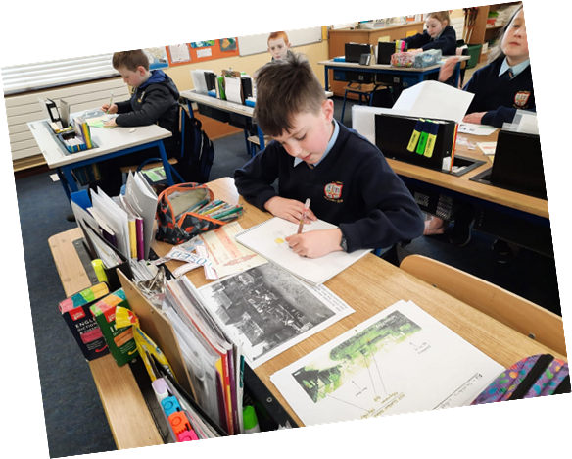
Drawing Strand
Notes:
Photographs provided a great source of visual context for the pupils and could be used to assist with observational drawings in additional to developing the skills of a historian :
Time and Chronology
Change and Continuity
Cause and Effect
Using Evidence
Empathy
Synthesis and Communication

Slide 19
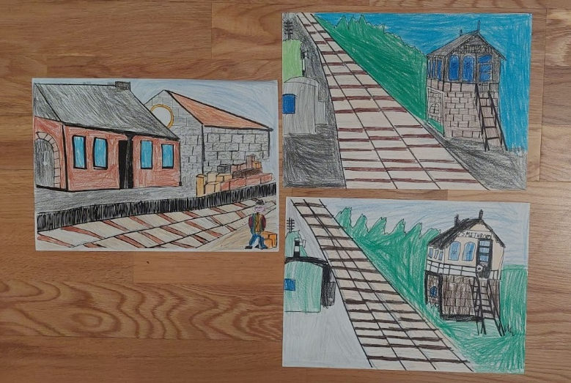
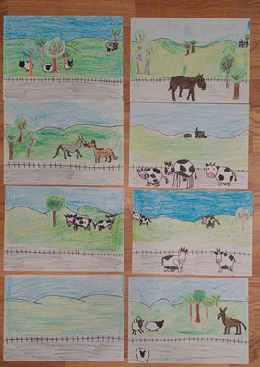
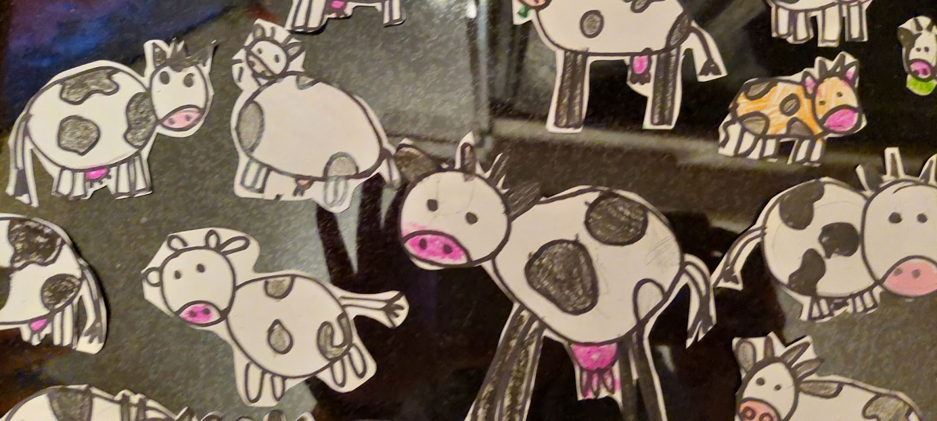
Drawing Strand
Notes:
Much drawing was completed.
Different approaches. Methodologies in different classes- Older classes pupils assigned specific tasks but the younger classes all shared every drawing experience.
Parallel to the drawing were classes in SESE to explore relevant content to the topics of The Ulster Canal, Smithborough Creamery and THE GNR -Smithborough Railway Station.
English and process writing relating to the genre ‘Information Reports’ was then explored in order to produce possible materials that could in turn be used as a script for the voice over work.
Poetry presented very naturally in Rang 1 agus 2 with the classes exploring Robert Louis Stephenson’s ‘From a Railway Carriage’ and a poem written by a local man titled ‘The Last Train through Smithborough’.

Slide 20
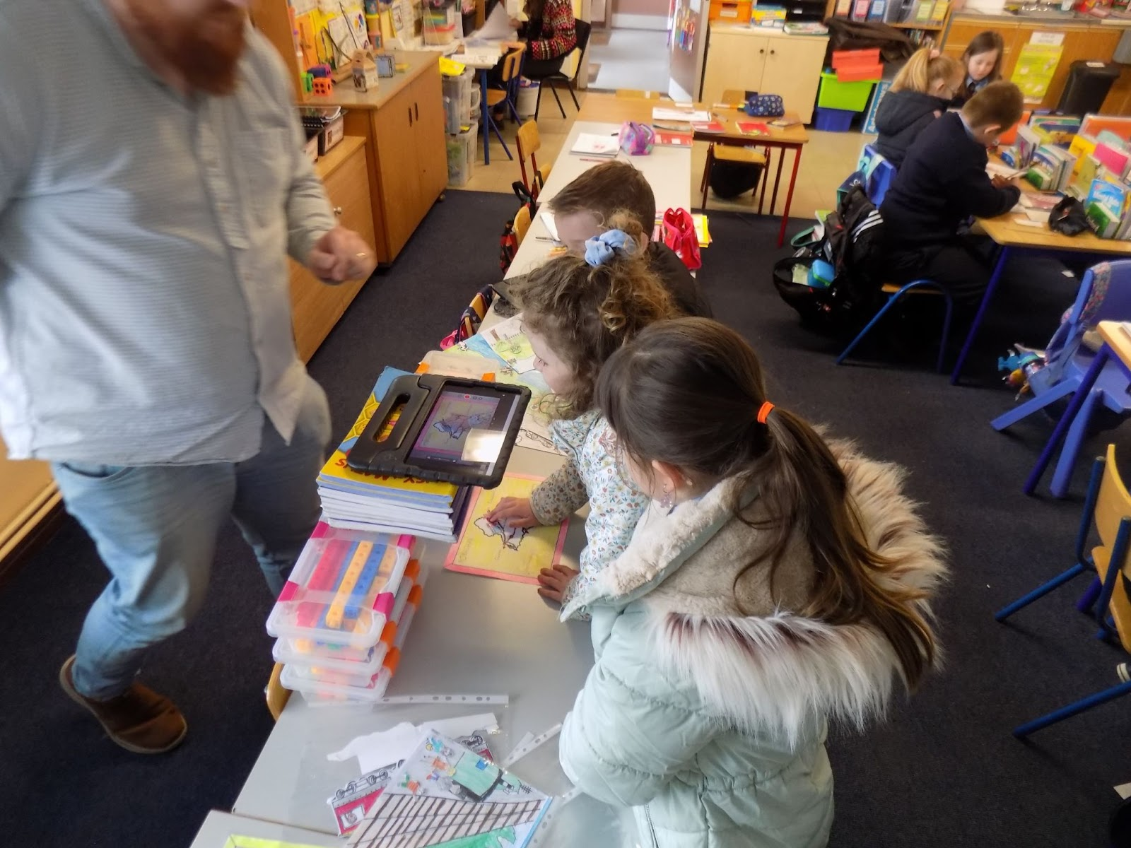
Animation Begins
Notes:
The animation process was initially led by John and it soon became apparent that the older classes of Rang 3-Rang 6 could work in groups on different sections of their information pieces while John worked with the pupils of Rang 1 & 2 group by group while the teacher completed other relevant group work.
After each visit John left clear instructions for the pupils and teachers as to what work we would need to have completed before his next visit.

Slide 21
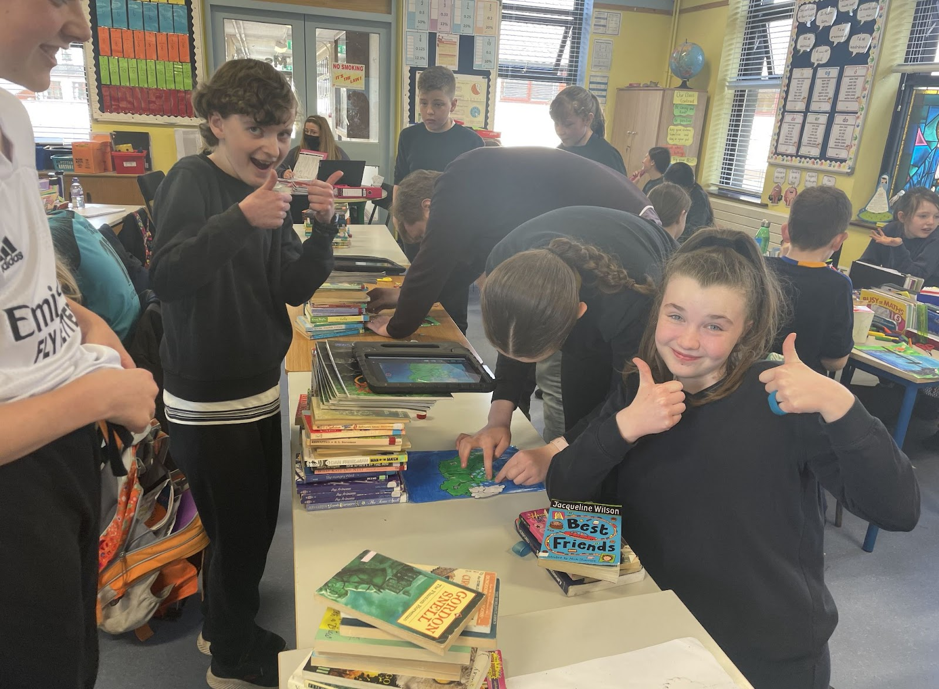
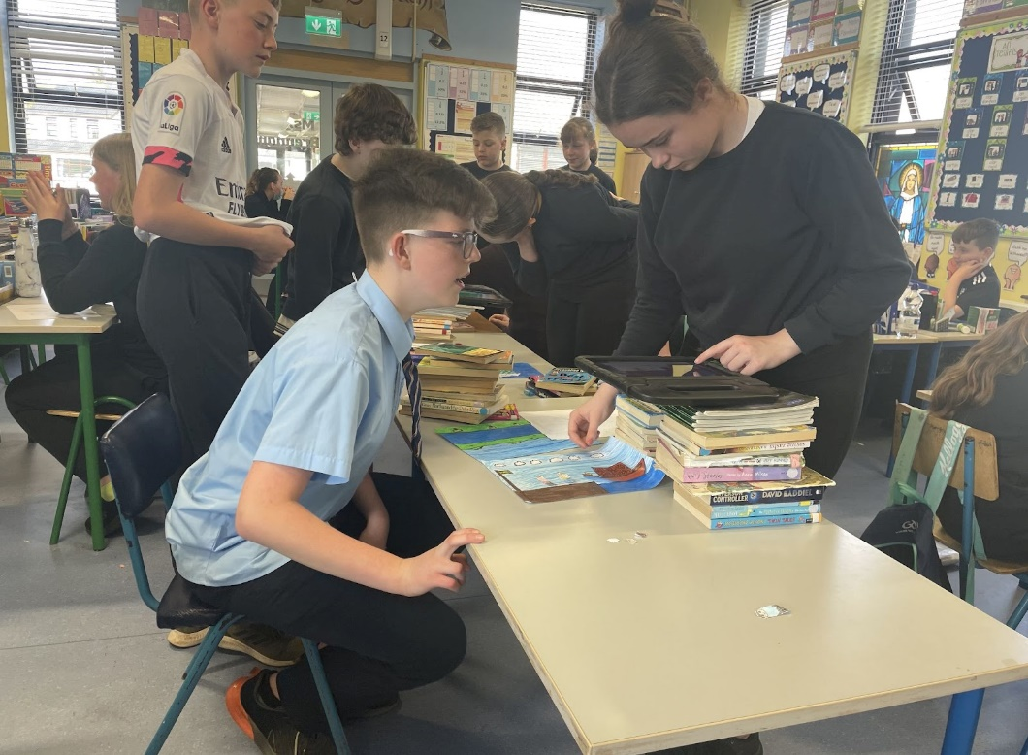
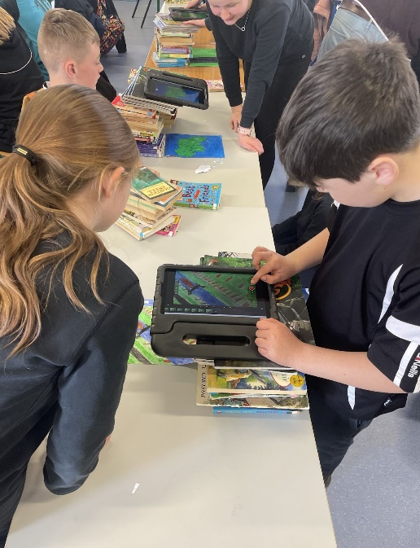
Animation Begins
Notes:
Provided great opportunity for grouping / pairing children who may not necessarily gravitate towards each other.
Once animations were completed sound effects appropriate to sections were recorded by the Junior and Senior Infants .

Slide 22
Pupil Thoughts
Creative Schools is really fun to do because I love to draw and colour pictures but I never knew I could make these pictures come alive with animation. Every school should do Creative Schools. Ella
Creative Schools is so fun because you get to draw things that you might never have before. I learned how to do animation and it was hard work but it was amazing after that.
Jamie
I enjoyed Creative Schools because we drew lots of things. I learned in the Creative Schools that you can do anything you put your mind to.
Kasparas
I like Creative Schools because I learn new things I never thought I could do like animation. Alex
Notes:
The school participated in so many creative activities and engaged with many artists and art forms over the two years.
Through the animation project – teachers also learned so much and will use these new skills in the future, really embedding creative learning and teaching in the school .The most important part of having a CA for the school was making connections with other arts and cultural organisations and engaging with artists and many art forms & helping coordinate the activities

